Slide 1

Features of a Good Presentation
By Team 3659 NeXt Gen

Slide 2
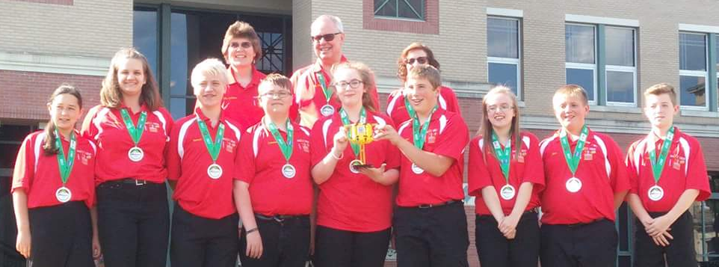
About Us
Middle school team from Garrett County, Maryland
13 years in FIRST LEGO League (including competing in International Tournaments)
First place 2013 Global Innovation Award for the Gramma Jamma
Top 20 GIA Semi-Finalist in 2017 for innovative solution, BeeHaven
First Place Innovative Solution at Mountain State Invitational in 2017

Slide 3
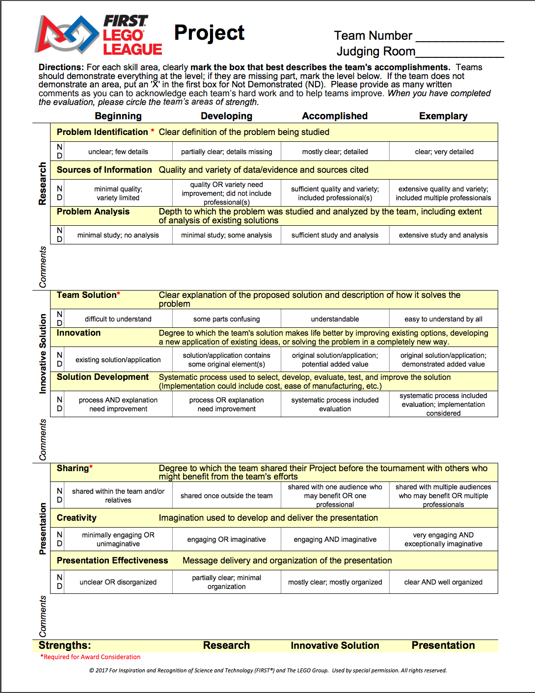
Start with the Project Rubric
Start by examining the FIRST LEGO League Project rubric.
We recommend writing a script for the presentation that includes everything that is required in the Project Rubric.
Highlight the three areas (Research, Innovative Solution and Presentation).
Tip: Cover everything on the rubric in the 5min presentation.
You can watch our video of our research project presentation at https://youtu.be/lbN3kgpQIOU
Note: New Rubric for 2017

Slide 4
Research Section
Problem Identification*: When planning the script, the team needs to discuss the problem they chose to solve and figure out how to state that problem in one clear sentence that everyone on the team knows.
Sources of Information: Somewhere in the presentation, the team needs to state what types of sources they researched and cited. This is where a bibliography helps.
Problem Analysis: The team needs to show that they know the problem and every aspect that contributes to that problem. In the presentation the team needs to explain the existing solutions, why the team’s solution is better, and what makes their solution their solution.
* Required for award consideration

Slide 5
Innovative Solution Section
Team Solution*: The team needs to be able to explain the solution in one sentence that is easy to understand by all. That sentence doesn’t need to include many details. It just needs to be a simple statement that is the overview of what the solution is. No technical description is required for this aspect.
Innovation: The team needs to explain to the judges how their solution is better and why their solution benefits others.
Solution Development: The team needs to explain how they developed and tested their solution. They also need to figure out the cost Your experts or professionals or a survey can help the team determine this. The team also needs to discuss how they would manufacture the solution. If it would be very complicated and difficult to manufacture, the team needs to discuss what they can do to improve the solution and make it easier to manufacture.
* Required for award consideration

Slide 6
Presentation Section
Sharing*: Somewhere in the presentation, the team needs to state that they shared their project with multiple people including groups and professionals. It’s always good to tell the judges about the feedback that was received and how the team improved their solution based off of that feedback.
Creativity: The presentation needs to be creative, engaging, informative, and fun! Don’t be afraid to be crazy or funny (wear hats/costumes) in the presentation. Judges love to see the teams having fun and smiling. You can add a theme. We recommend newscasts or movie themes for the presentation.
* Required for award consideration

Slide 7
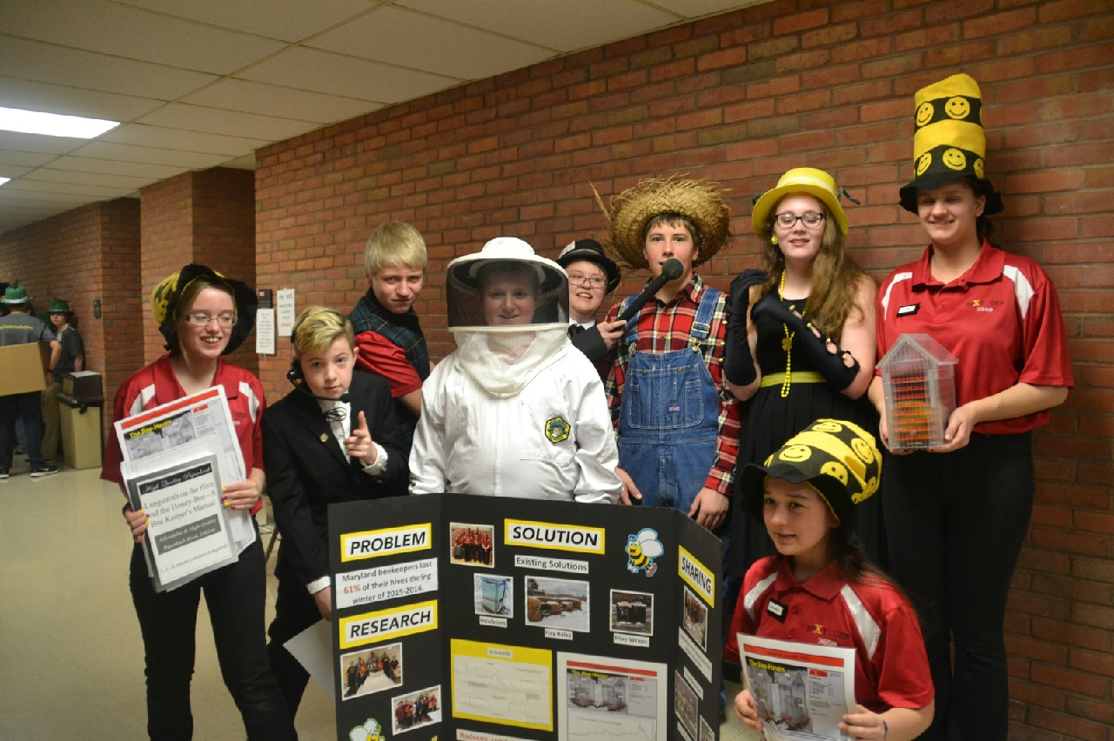
Presentation Section, Cont.
Presentation Effectiveness: Overall, the presentation must clearly explain the the problem, team’s solution, why it’s innovative, how feasible it is, etc. Try to memorize your script instead of reading it. Keep the lines short so that they are easy to memorize. Make sure that everyone on the team participates. When a team member is giving their lines, the whole team needs to be engaged.

Slide 8
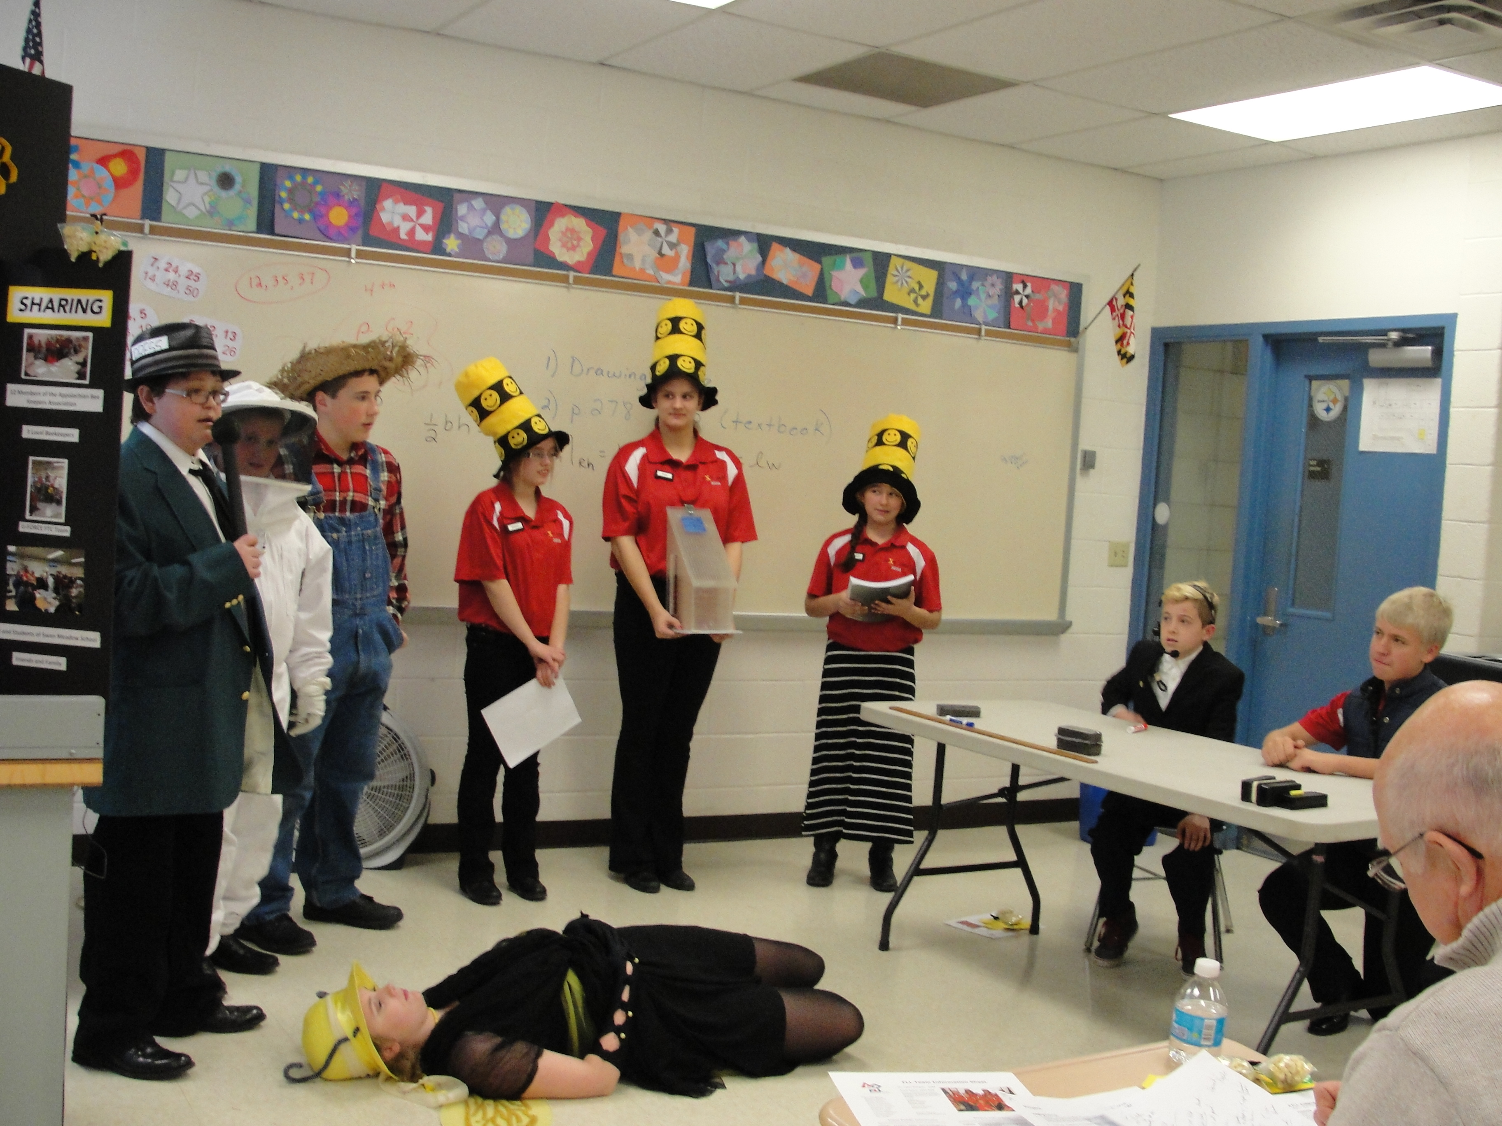
Judges’ Questions
After the presentation, judges ask questions. The judges may ask a specific team member or they may ask the whole team.
Choosing a “captain” for that judging session can be useful. The captain helps direct the questions and makes sure everyone on the team answers a question.
The captain does have to answer a question, too.
Whoever is the captain needs to know what each team member is most comfortable talking about. For example, say the judges ask a question about the existing solutions and why they don’t work. The captain could say, “ I know Sara researched that topic. Sara, would you like to answer the question?”
You can give the judges additional information if they don’t have any questions.
Everyone on the team needs to be able to answer questions and when a particular person is answering the entire team should be engaged

Slide 9
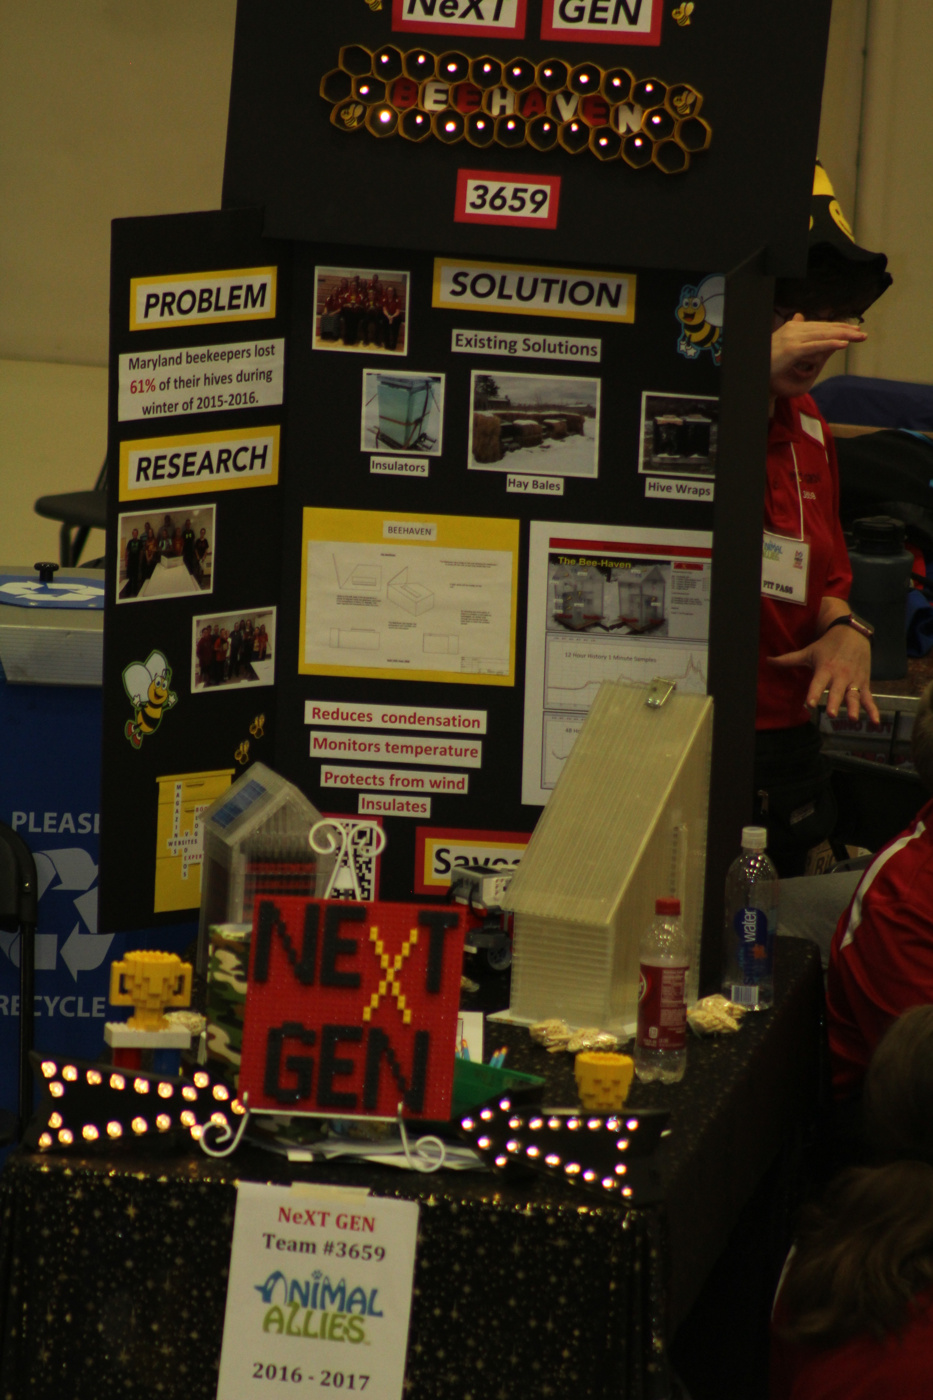
Display Boards
Having a display board at the pit area sparks conversation and is useful when judges visit. The team can bring this display board into judging as well.
The display board can be used to explain the team’s research project.
We recommend using the research project rubric to help in the design layout of the board.
Draw the layout of the display board and plan out where certain information needs to be.
Include several photos of the team and the solution.
Typed descriptions enhance the look of the display board.
Tip: Use both sides of the board to allow for more information.

Slide 10
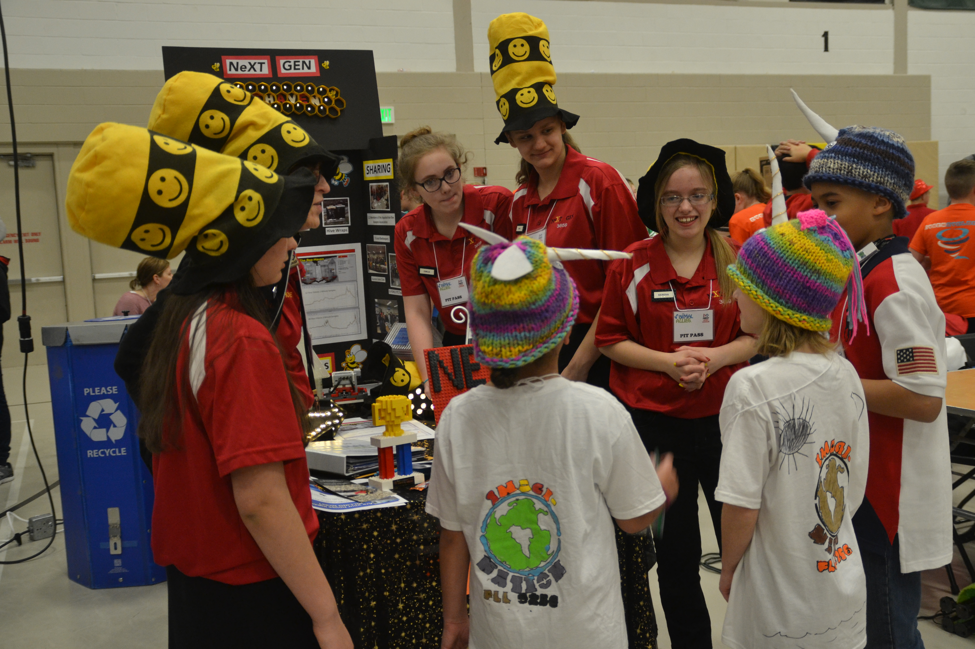
Team Notebook
A team notebook is a good way for other teams, judges, and visitors to get to know the team. The team can bring their notebook into judging to show the judges. It’s nice way to remember the season, too.
Here are some things you might include in your team notebook:
Introduction to the team members/coaches/mentors
Photos from competitions
Information about the project
Photos and description of the team sharing and demonstrating their project
Documentation about the solution development
Judges handouts
Thank you letter to sponsors
Marketing plan
Newspaper articles about the team

Slide 11
Judges Handouts
Teams can create handouts to give to their judges.
Judges handouts can be used to highlight the main points of the team’s presentation and to remind the judges of the team
Design the judges handouts to be a quick reminder of the presentation
Do not include long paragraphs explaining the team’s project
Consider the judging rubric when designing the judges handouts
Be creative! For our Animal Allies season, we made hexagon shaped handouts to represent honeycomb since our project was related to bees.

Slide 12

Credits
This lesson was written by Team 3659 NeXT GEN, with some edits by EV3Lessons
You can contact Team 3659 NeXT GEN through their Facebook page: Garrett County FIRST LEGO League Team 3659.
More lessons available at www.ev3lesssons.com

